Slide 1

AI Health Dashboard
Chronic Disease Risk Prediction & Recommendations
-Divya Mevada

Slide 2
The Challenge of Chronic Diseases
Chronic diseases such as diabetes, heart disease, and hypertension are significant global health burdens and leading causes of mortality. Current healthcare systems often fall short in providing the personalized, continuous monitoring essential for early detection and proactive management of these conditions.

Slide 3



Our Vision: Predictive & Proactive Health
Predict Disease Risk
AI-Powered Health Tips
Visualize Health Trends
Leveraging advanced AI to forecast individual susceptibility to chronic conditions.
Delivering personalized health recommendations based on predictive analytics and user data.
Providing intuitive dashboards for tracking key health metrics over time.

Slide 4
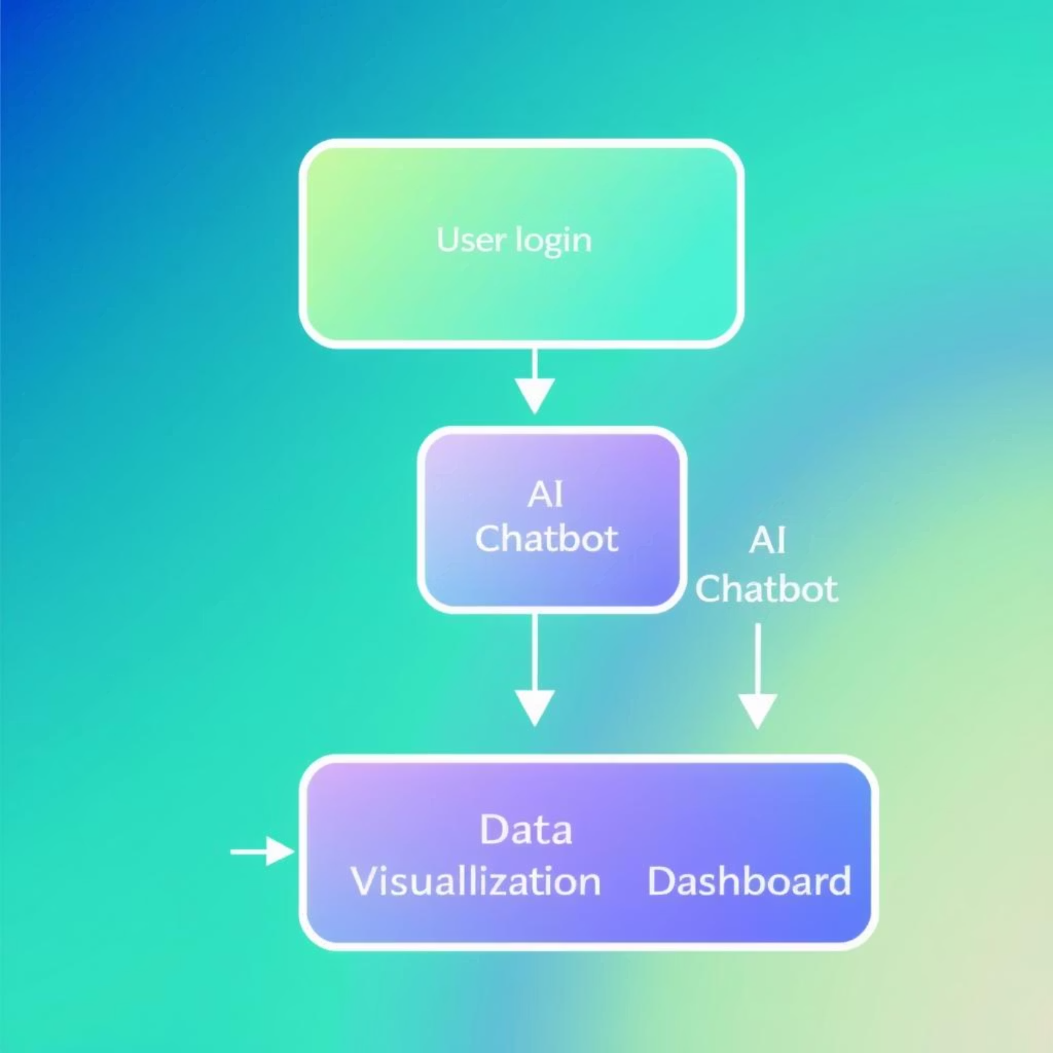
Solution Overview: AI Health Dashboard
Web Application
Data Visualization & Tracking
Flask Web App with secure login
Dynamic Dashboards using Chart.js/Plotly
User-friendly interface for seamless interaction
Comprehensive health history tracking over time
Core Intelligence
Machine Learning Model for chronic disease risk prediction
Gemini AI Chatbot for interactive health guidance

Slide 5




Technology Stack
Backend
Machine Learning
Python
Scikit-learn
Flask
Joblib
MySQL
Frontend
Artificial Intelligence
HTML, CSS
Google Gemini API
Bootstrap
Chart.js

Slide 6
Key Features at a Glance
Health Prediction
Gemini Chatbot
Health Dashboard
Accurate risk assessment for chronic diseases.
Interactive AI for personalized health advice.
Visual insights into key health metrics.
Health History
Authentication
Track progress and trends over time.
Secure login for data privacy.

Slide 7
Machine Learning Model: The Core of Prediction
Our machine learning model is trained to predict chronic disease risk based on key health indicators. The model processes various inputs to generate a binary output: indicating either a low or high risk.
Output:
0 = Low Risk
1 = High Risk
Key Inputs:
Model Evaluation Metrics:
Age
Accuracy: Overall correctness of predictions.
BMI (Body Mass Index)
Precision: Proportion of true positive predictions among all positive predictions.
BP (Blood Pressure)
Recall: Proportion of true positive predictions among all actual positives.
Glucose Levels
Insulin Levels
F1-Score: Harmonic mean of precision and recall.
Number of Pregnancies (for specific conditions)

Slide 8
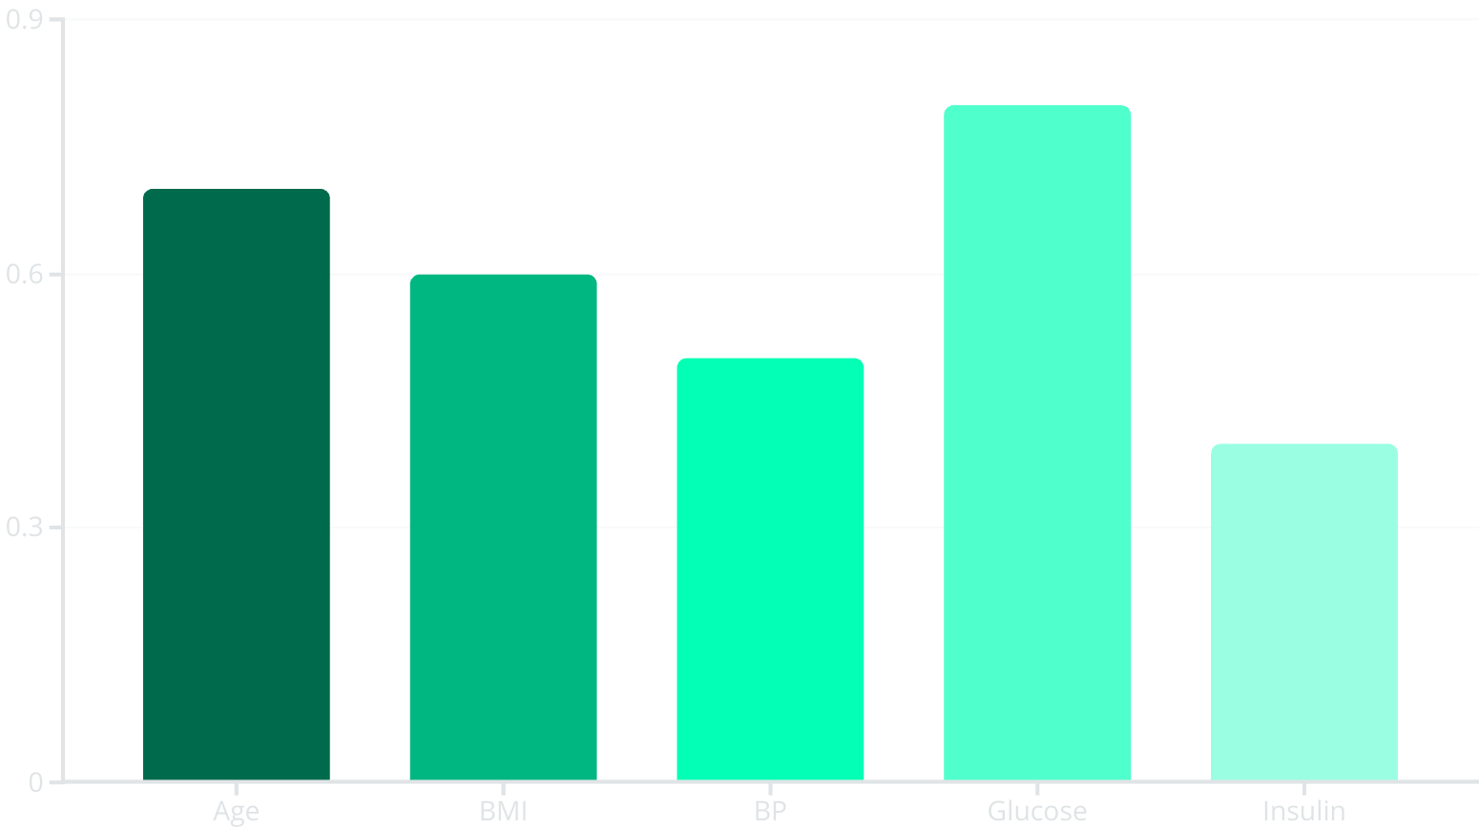
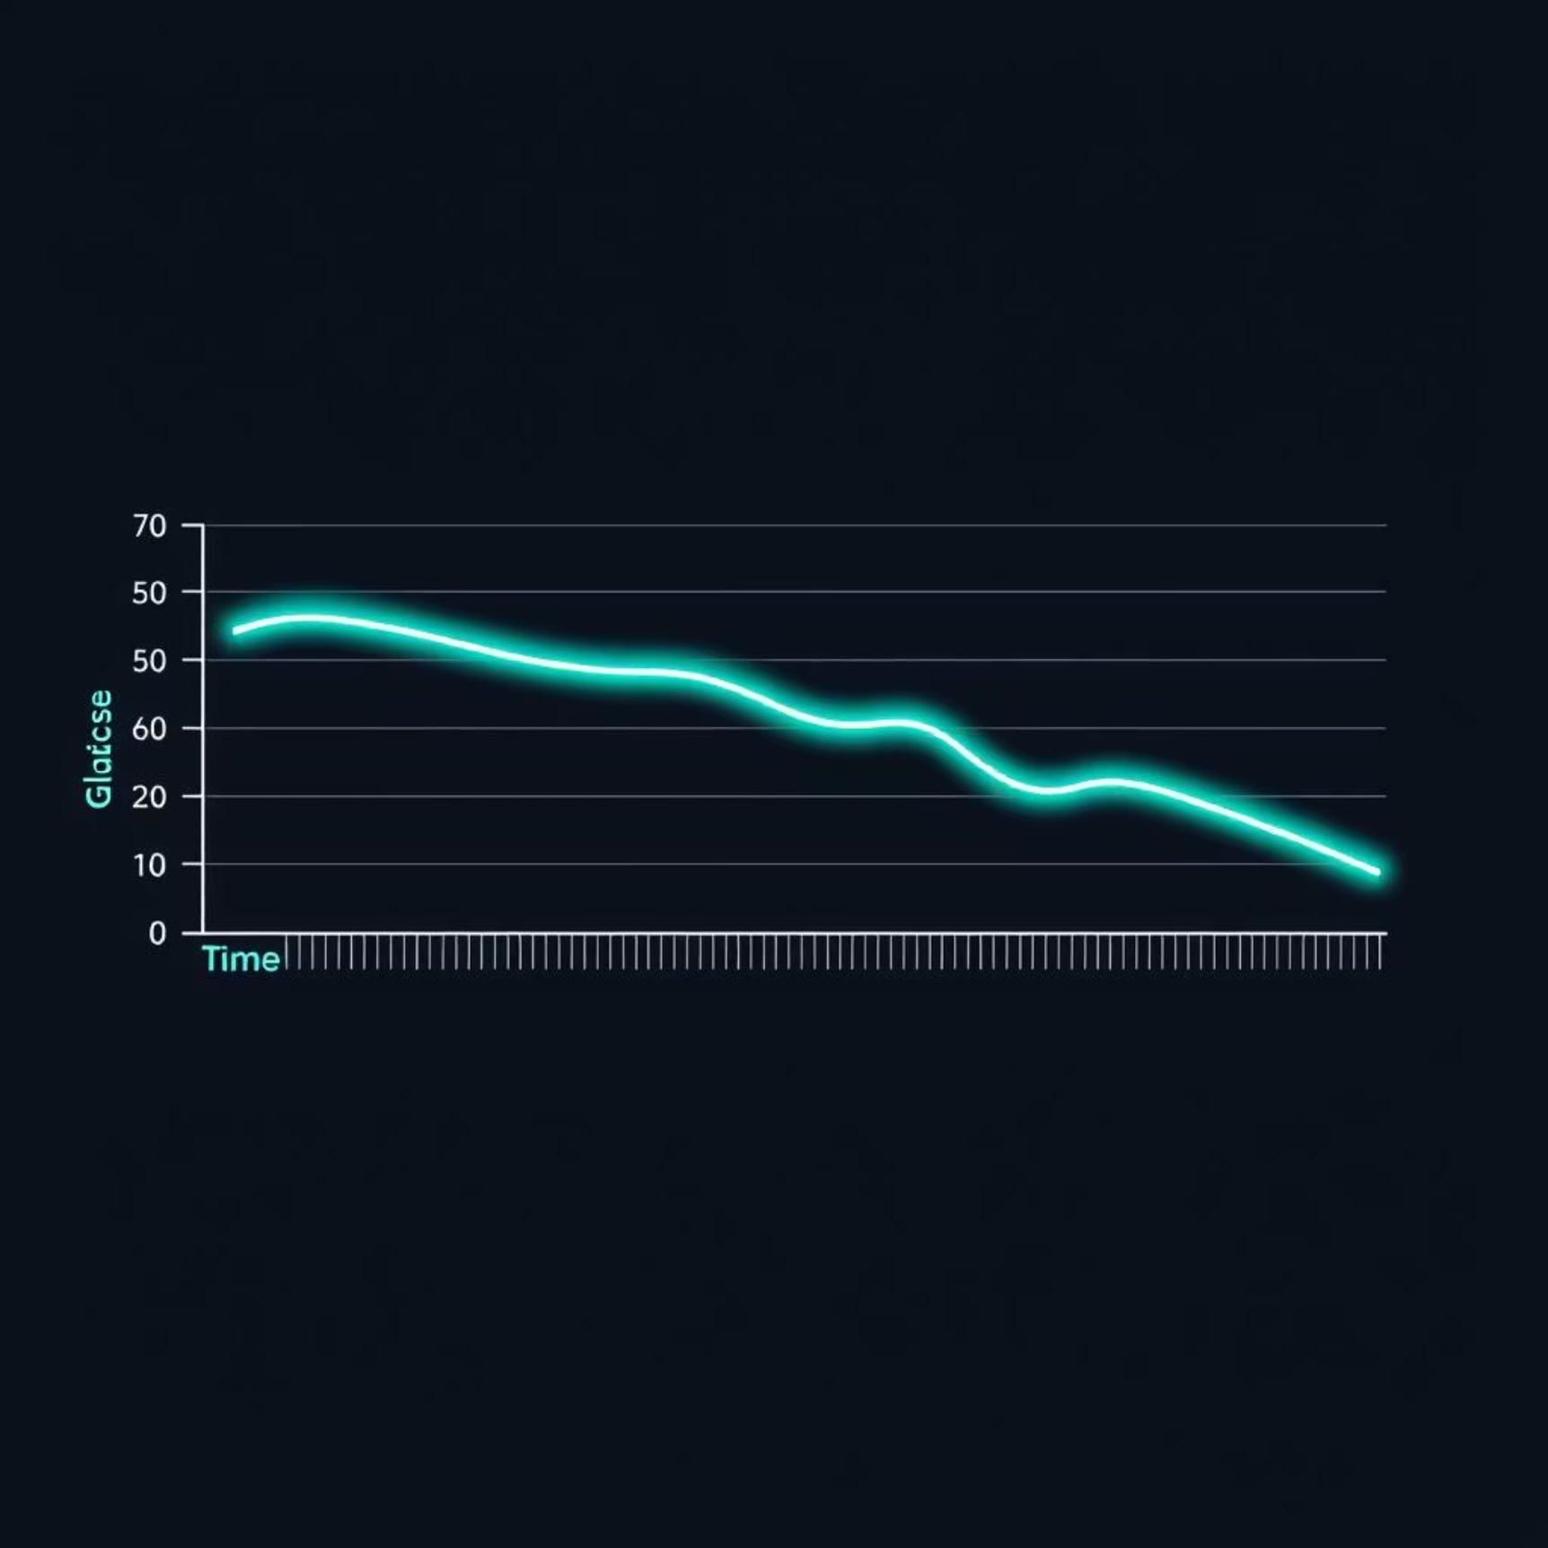
Interactive Health Dashboard
The dashboard provides dynamic visualizations to help users understand their health data at a glance. Visualizing trends over time is crucial for proactive health management.
Radar Chart: Visualizes normalized health factors to identify areas needing attention.
Line Charts: Track trends in key metrics like Glucose, BMI, and Blood Pressure over time, enabling users to monitor their progress.

Slide 9

Gemini AI Assistant: Your Personalized Health Companion
The AI Assistant provides intelligent, empathetic, and personalized health guidance. It leverages the power of Google Gemini to deliver tailored advice.
Contextual Learning: The AI learns from your last 5 health entries, enabling highly relevant and adaptive recommendations.
Personalized Messaging: Responses are crafted with your username and specific context, fostering a more engaging and supportive user experience.
Emoji-Rich Communication: Messages incorporate emojis to create a friendly and approachable tone, enhancing user interaction and engagement.

Slide 10

Robust Security Measures
Data Protection
Hashed Passwords: User passwords are encrypted using strong hashing algorithms, ensuring sensitive data remains secure even in the event of a breach.
Session-Based Login/Logout: Secure sessions prevent unauthorized access and protect user data during interactions with the dashboard.
System Integrity
Admin Retraining Option: Administrators have the capability to retrain the ML model, ensuring its continuous accuracy and adaptation to new data patterns, thus maintaining the system's predictive power.

Slide 11
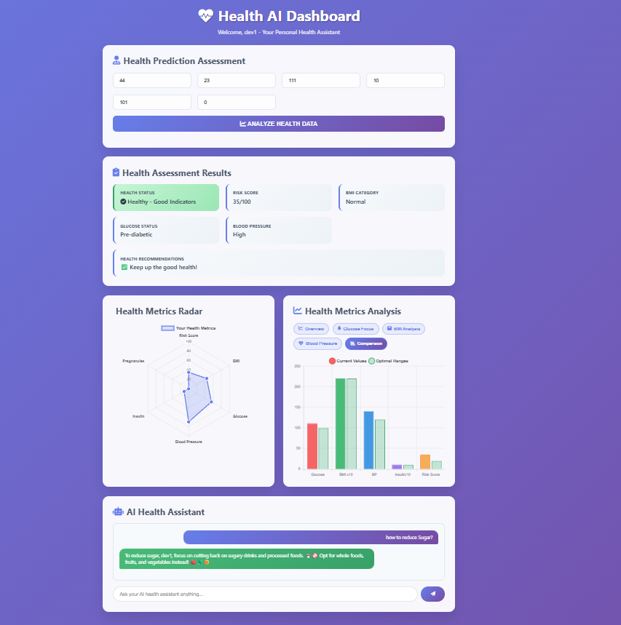
User Interface

Slide 12
GitHub Link:
https://github.com/divya25-mevada/AI-Health-Dashboard

